Slide 1
Loan Risk Analysis

Slide 2
Data
Source:
Lending Club
Loan Application data
Borrower financial and demographic data
Loan status data
Range:
Time range from 2007 to 2018
145 columns and 2.2 million rows

Slide 3
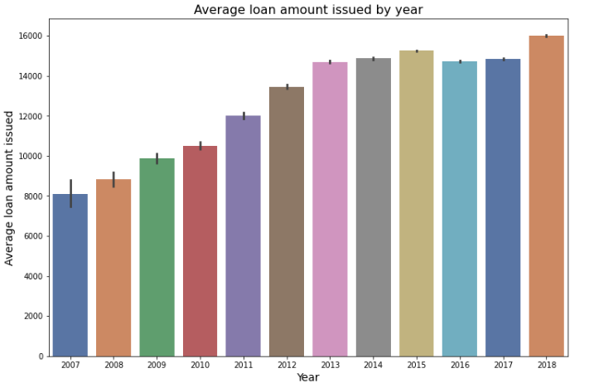
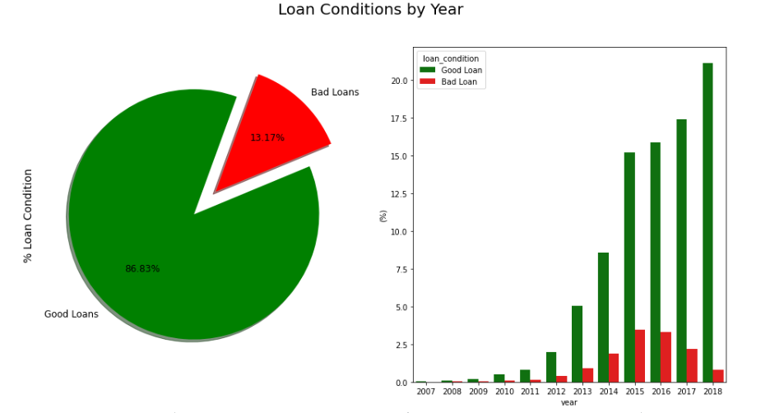
Exploring Data

Slide 4
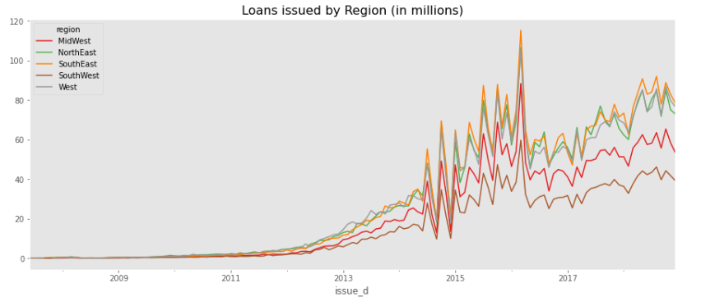

Slide 5
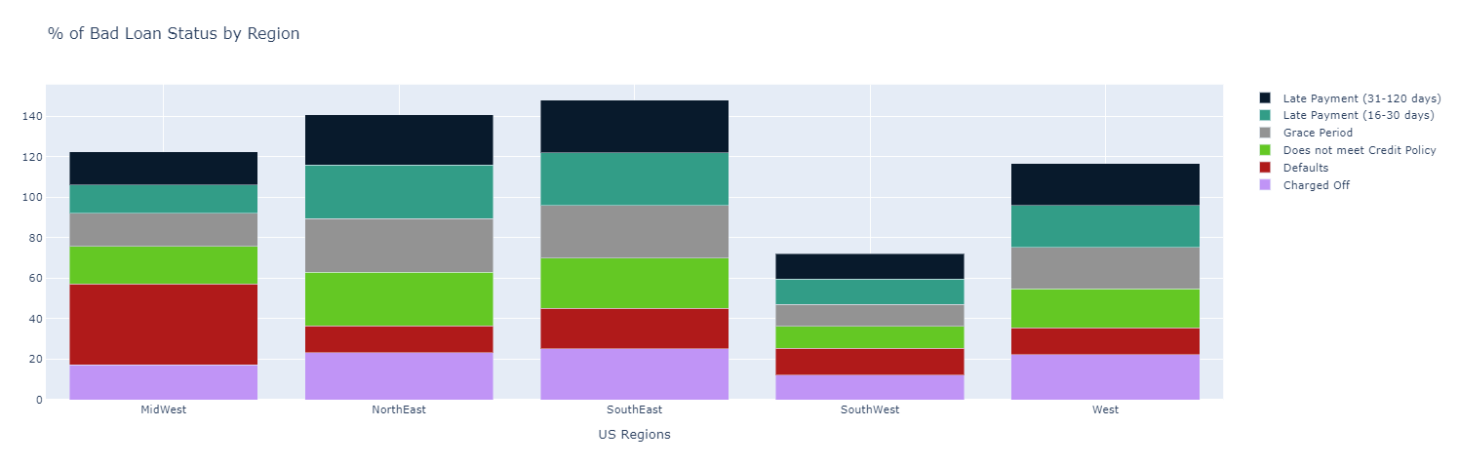

Slide 6
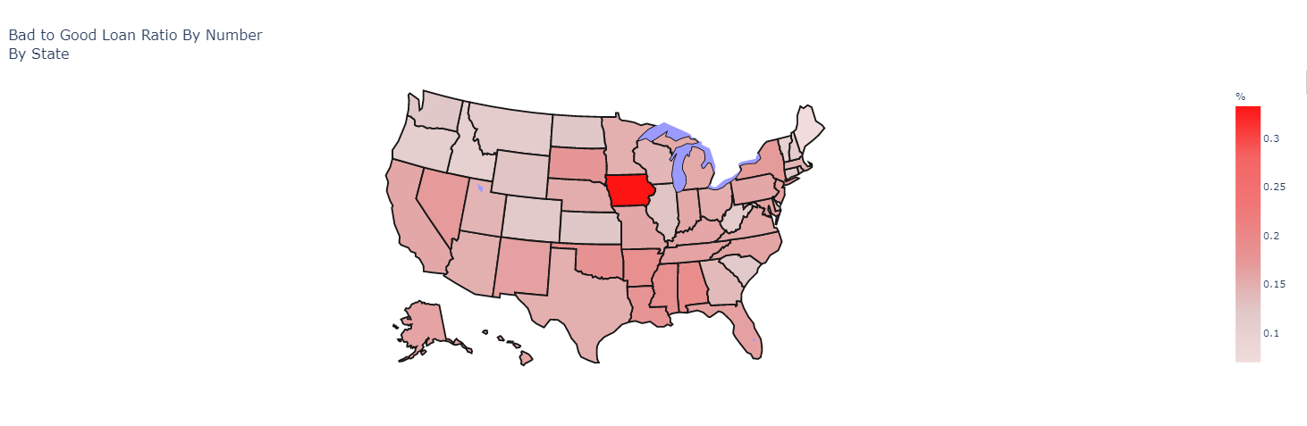

Slide 7
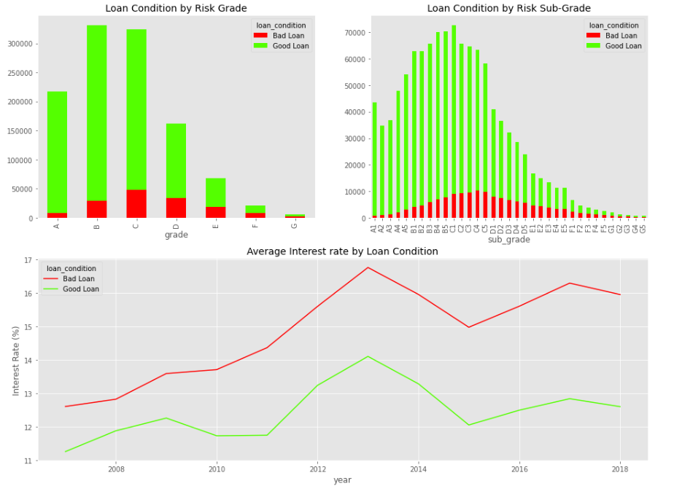

Slide 8
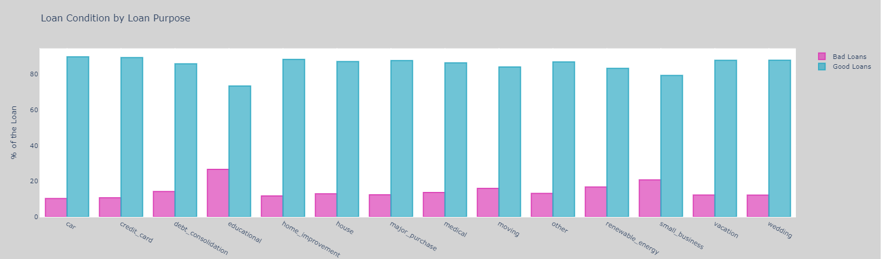

Slide 9
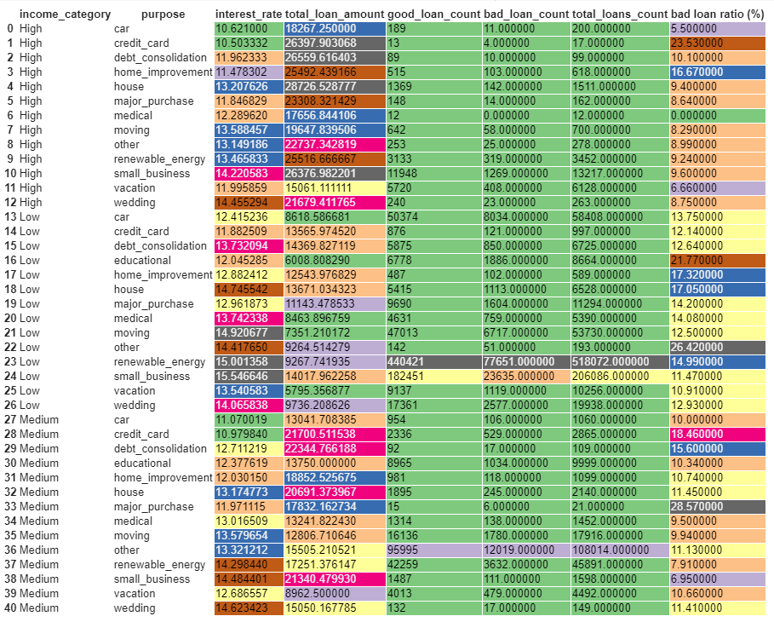

Slide 10
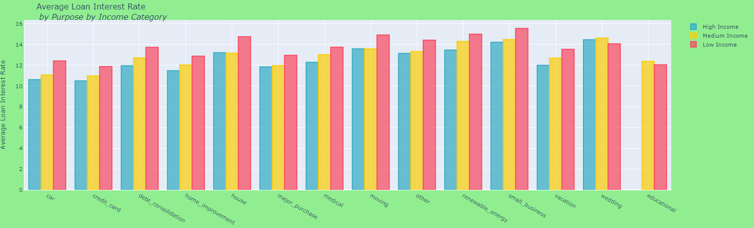

Slide 11

Feature Engineering
Imput missing data by two layers of statistics(group by and then mean/mode)
numeric data
categorical data
Split training set and test set by stratified sampling to maintain the imbalance ratio of classes

Slide 12
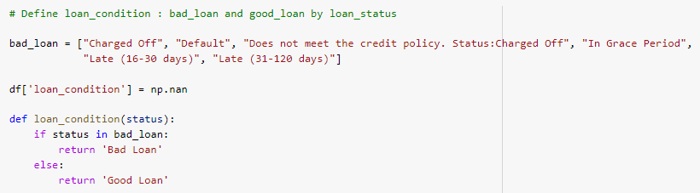
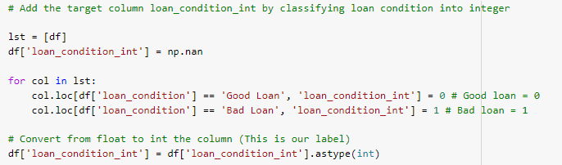
Classify target label : good loan (0) and bad loan (1)
from loan status

Slide 13
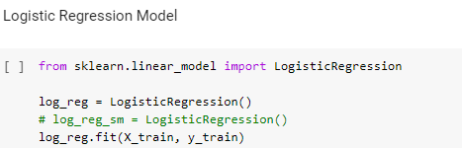
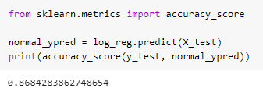
Algorithm
Logistic Regression - for binary classifier using simple algorithm
Accuracy = 86.84%

Slide 14
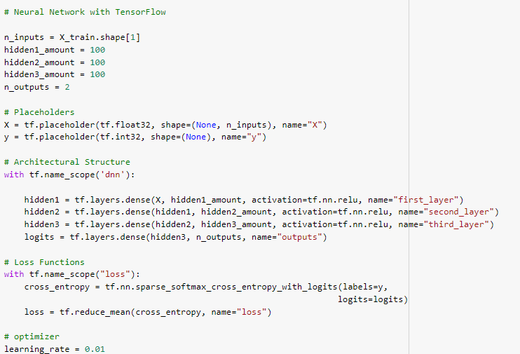
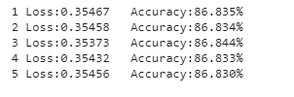
Tensorflow Deep Neural Network - to see if any improvement by using complex algorithm for simple classifier problem
Accuracy = 86.38%

